Slide 1
Mars surface viewer

Slide 2



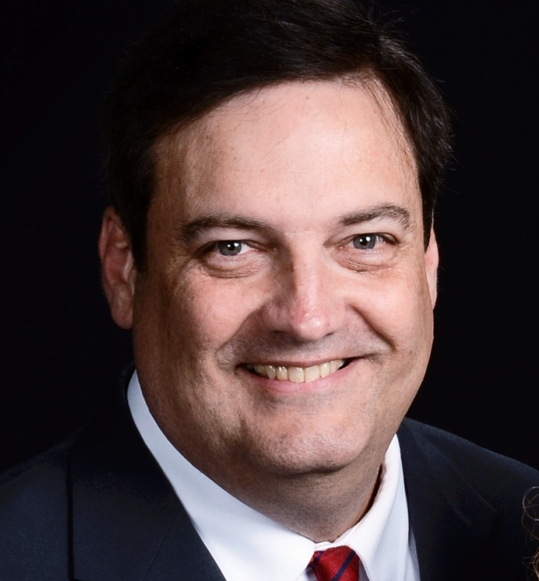
David Goldhagen - Senior
San Antionio, Texas
Joshua Parker - Senior
Lithonia, Georgia
Collin Pike - Junior
Roanoke, Alabama
Gary Pike - Junior
Roanoke, Alabama

Slide 3
Project Name: Mars surface viewer
Team Name: Unknown
Project Manager: Gary Pike – Junior
Software Engineering & Business Finance
Chief Coder: Collin Pike - Junior
Software Engineering & Business Finance
HTML Designer: Joshua Parker – Senior
Computer Science
Project Researcher: David Goldhagen – Senior
Electrical & Computer Engineering

Slide 4
Program by Cybermen AKA
Team Unknown
Project Manager: Gary Pike
Chief Coder: Collin Pike
HTML Designer: Joshua Parker
Project Researcher: David Goldhagen

Slide 5
Purchased a domain name: marsrover.space
Hosting web page from our source code.
Created 4 Webpages: home page and a page for each of the rovers
Main page: click a picture to view information on it
Rover pages:
Picture of desired rover
Enter camera angle
Enter Earth or Sol date
Click go button to view pictures from rover
Explains what a Sol is
A button to go back to main page (bottom of page)

Slide 6
Summary
Purchased a domain name: marsrover.space
Hosting web page from our source code.
Created 4 Webpages: home page and a page for each of the rovers
Main page: click a picture to view information on it
Rover pages:
Picture of desired rover
Enter camera angle
Enter Earth or Sol date
Click go button to view pictures from rover
Explains what a Sol is
A button to go back to main page (bottom of page)

Slide 7
Analysis of Problem

Slide 8
Preliminary Plan of Attack

Slide 9
Road Blocks

Slide 10
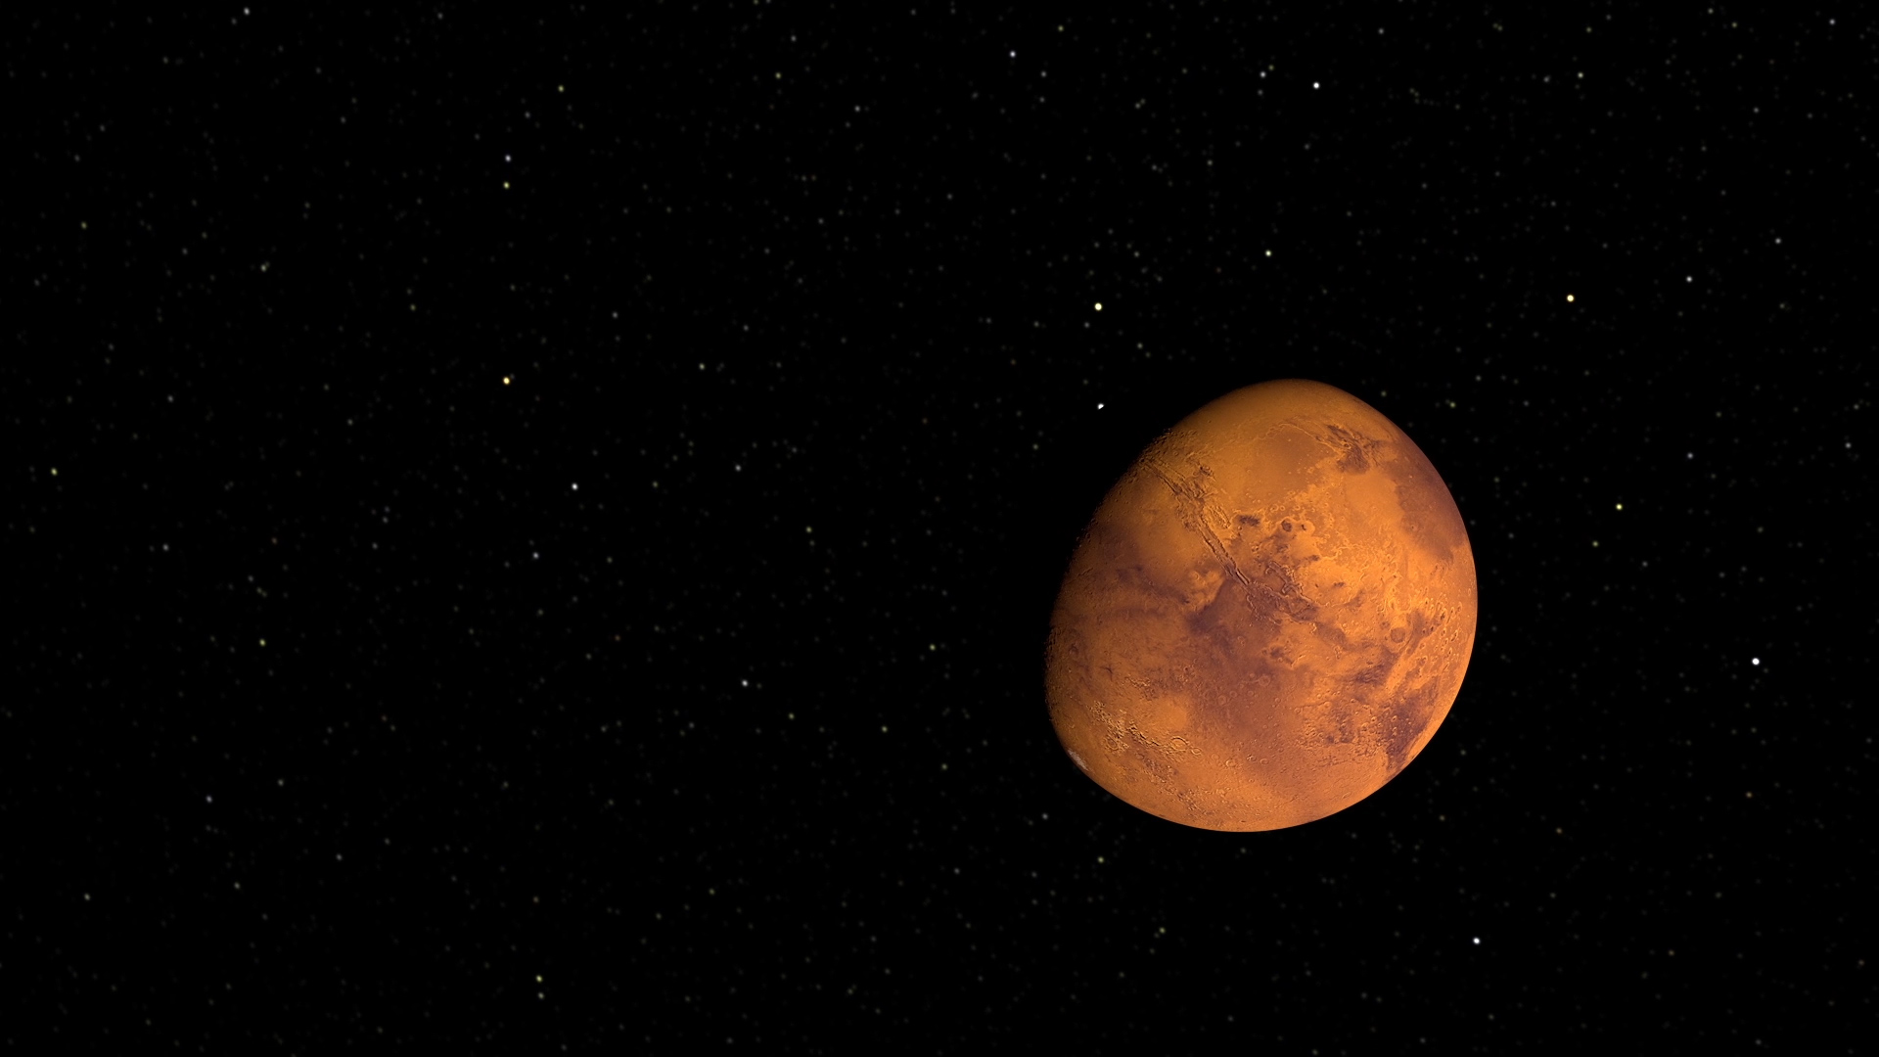
Actual Solution

Slide 11
Auburn Hackathon2017
Team Unknown:
Gary Pike: Software & Aerospace Engineering Senior
Joshua Parker: Computer Science Senior
Collin Pike: Software Engineering Senior
David Goldhagen: Computer Engineering with EE option Junior

Slide 12

The secret to creativity is knowing how to hide your sources. – Albert Einstein

